Slide 1


IPL Data Analysis
Done By: -
D Chaitanya (2010030045)
MTV Soumith (2010030097)
K Vamshi (2010030326)
K Tribhuvan (2010030402)
K Sai Bhargav (2010030535)
Group No:- 5

Slide 2
Table of contents
Introduction/ Abstract
Literature Review
Hardware and software Requirements
Data sets
Data Preprocessing
Model building/Algorithm
Outputs
Outputs with graphs and explanation
Code explanation
Conclusion
Future Scope
References

Slide 3
Introduction/Abstract
In cricket, IPL stands for Indian Premier League, a T20 cricket tournament which was originally established in 2008. It is traditionally played from April through to June each year and, from 2022, the competition will be expanded to include a total of ten teams.
IPL DATA ANALYSIS

Slide 4
Literature Survey
S. No | Authors | Title | Published on | Publishing Techniques/models | Results
1. | Amala Kaviya V.S, Amol Suraj Mishra and Valarmathi | Comprehensive Data Analysis and Prediction on IPL using Machine Learning Algorithms | April,2020 | SVM(Support Vector Machine),FDA(Functional Data Analysis) | A detailed analysis of the complete IPL dataset and visualization of various features necessary for IPL evaluation is performed. Many machine learning algorithms have been used to compare and predict the winner between any two teams.
2. | G. Sudhamathy and G. Raja Meenakshi | Prediction On IPL Data Using Machine Learning Techniques in R Package | October,2020 | Classification(Decision Tree, Naive Bayes, Random Forest, K-Nearest Neighbours) | It creates the Model and Training dataset and helps to predict with the help of the model created. The model classifies the data and compares the results. It takes into consideration the measures accuracy, error rate, precision, recall, sensitivity and specificity. This work focuses on exploring IPL data and presenting its insights as graphical representation and comparative analysis.
3. | Praveen Banasode, Minal Patil, SupriyaVerma | Analysis and Predicting Results of IPL T20 Matches | May,2021 | Performed the calculations on individual players like batsman, bowler, all-rounder and fielder on different dataset. | By this data analysis we can find out the pros and cons of the player and work on the performance of the individual player and the whole, it will help in taking decision.
4. | V Narmadha, S Sneha and C Vishali | Recognizing Eminent Players from the Indian Premier League Using CNN Model | February,2022 | Sentiment Analysis, R packages | The intention of this paper was to develop a CNN model to determine the famous IPL player by analyzing tweets from Twitter.
5. | Balanand Jha, Rahul Raj, Mrigendra Kumar Bharti, Shubham Kumar, Kumar Abhishek and Akshay Deepak | Sentiment Analysis of IPL Teams Using Supervised Machine Learning Approach | February,2020 | Sentiment Analysis, Support Vector Machines, Feature Vector Extraction | In this paper, they performed sentiment analysis of user comments on Twitter to gain insights into the performance of various IPL teams using supervised machine learning techniques. And collected tweets using Python library tweepy. They shown the team that has most positive public opinion while and team that has most negative.
IPL DATA ANALYSIS

Slide 5
Hardware and software requirements
Windows XP or later version
1 GB ram
R Studio latest Version
Microsoft Office 365
Optional : Internet

Slide 6
Dataset
We have collected the dataset from Kaggle and many other sources.
We have collected the IPL Data from 2008 to 2022.
We have more than 3 lakhs rows in the dataset.
We have used two datasets :
One is for IPL matches and another one is for ball-ball analysis.

Slide 7
Data Pre Processing
We have collected the data set form Kaggle.
Next we imported the useful libraries for R programming.
We didn’t find any errors or missing values in the dataset.

Slide 8
Model building/Algorithm
We didn’t used any model or Algorithm

Slide 9
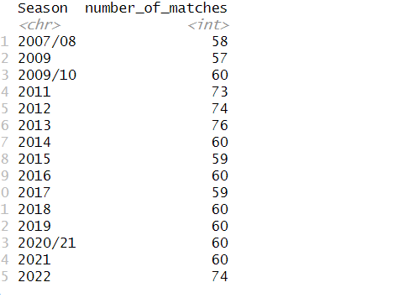
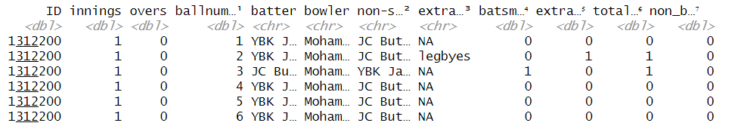
Outputs

Slide 10
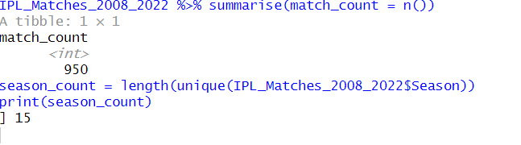
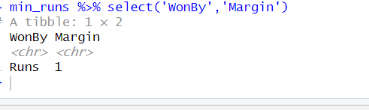

Slide 11
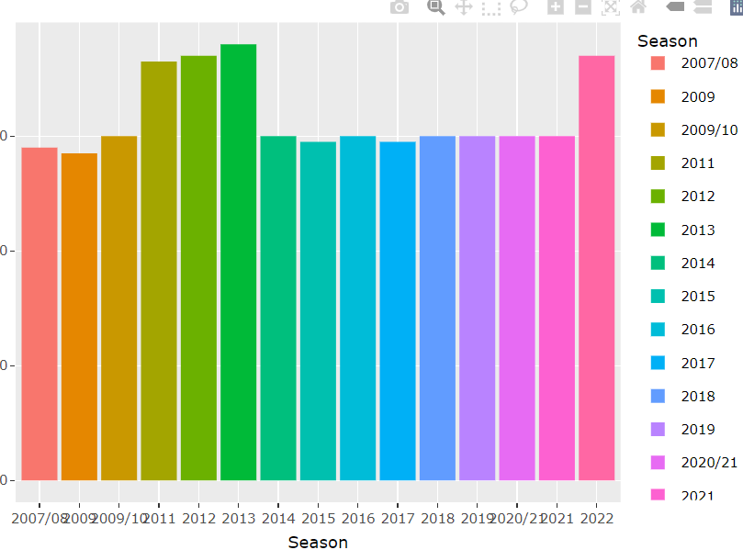
Screenshots with graphs and charts
This is the season wise with more number of matches that is played in the season.

Slide 12
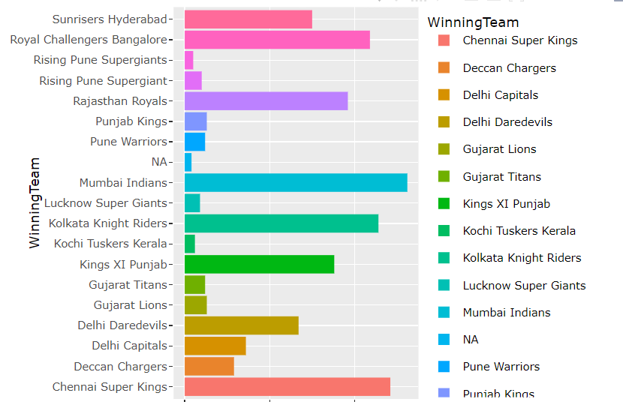
The team which has won more number of matches till date.

Slide 13
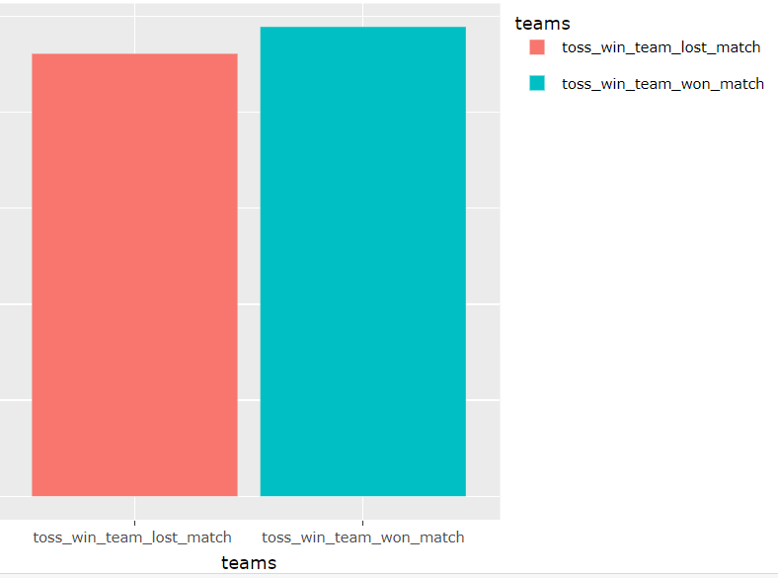
Winning count based on the toss

Slide 14
Code explanation
IPL_Matches_2008_2022 %>% group_by(Player_of_Match) %>% summarize(awards = n()) %>% top_n(10) %>% ggplot(aes(x = Player_of_Match, y=awards, fill=Player_of_Match)) + geom_col(position="dodge") + labs(x="Player_of_Match", y = "Awards" , title = "Top 10 Player Man of the Match") + coord_flip()
Here group by function will combine one or more number of player in the match and summarize function is compared to each team and top(10) will take the top 10 players and ggplot function will plot the bar graph

Slide 15
Conclusion
All this work aims at understanding the dataset of past 10 years history of the IPL data.
Selection of the best team for a match plays a major role for the team’s finish. The main goal of our is to analyse the IPL cricket data and predict the end result of a match.
IPL DATA ANALYSIS

Slide 16
Future scope
In future we have the idea to implement the same project to a website or application.

Slide 17
bibliography / References
[1] A. K. Jain, M. N. Murty, and P. J. Flynn, “Data clustering: a review”, ACM Computing Surveys 31 (3), pp: 264–323, 1999.
[2] J. Han, M. Kamber, and J. Pei, Data Mining: Concepts and Techniques, second ed., Morgan Kaufmann, California, 2005.
[3] P. Berkhin, Survey of clustering data mining techniques, Technical Report, Accrue Software, Inc., 2002.
[4] R. Xu and D. Wunsch, “Survey of clustering algorithms”, IEEE Transactions on Neural Networks 16 (3) 645–678, 2005.
[5] M. Filippone, F. Camastra, F. Masulli, and S. Rovetta, “A survey of kernel and spectral methods for clustering”, Pattern Recognition 41, 176–190, 2008.
[6] L. A. Zadeh, Fuzzy sets: Information and Control, 1965.
[7] L. A. Zadeh, From search engines to question-answering systems the role of fuzzy logic, University Berkeley, California.
[8] H. Lee, K. H. Park, and Zeungnam Zenn Bien, “Iterative Fuzzy Clustering Algorithm with Supervision to Construct Probabilistic Fuzzy Rule Base From Numerical Data”, IEEE Transactions on Fuzzy Systems, Vol.16, No.1, June, 2008.
[9] M. M. Chacón and S. J. Nevarez, A Fuzzy Clustering Approach on the Classification of Non-Uniform Cosmetic Defects.

Slide 18

Thank You
IPL DATA ANALYSIS

